Slide 1
Chapter 1 Problems and Exercises

Slide 2
Problem 1
1. For each of the following pairs of related entities, indicate
whether (under typical circumstances) there is a one-to -many
or a many-to-many relationship. Then, using the shorthand notation introduced in the text, draw a diagram
for each of the relationships.
STUDENT and COURSE (students register for courses)
BOOK and BOOK COPY (books have copies)
COURSE and SECTION (courses have sections)
SECTION and ROOM (sections are scheduled in rooms)
INSTRUCTOR and COURSE

Slide 3
Problem 5
5. Consider a student club or organization in which you are a
member. What are the data entities of this enterprise? List
and define each entity. Then, develop an enterprise data
model (such as Figure 1-3a) showing these entities and important
relationships between them.

Slide 4
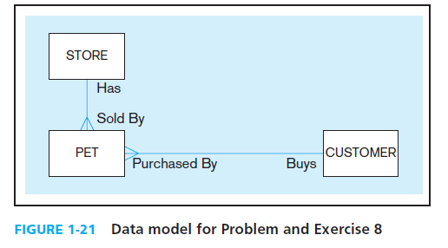
Problem8
Figure 1-21 shows an enterprise data model for a pet store.
a. What is the relationship between Pet and Store (one-to-one, many-to-many, or one-to-many)?
b. What is the relationship between Customer and Pet?
c. Do you think there should be a relationship between Customer and Store?

Slide 5
Problem 12
12. Consider your business school or other academic unit as a business enterprise.
Define several major data entity types and draw a preliminary enterprise data model (similar in notation to Figure 1-3a).
Would your business school or academic unit benefit from
a multiple-tiered architecture for data? Why or why not?

Slide 6
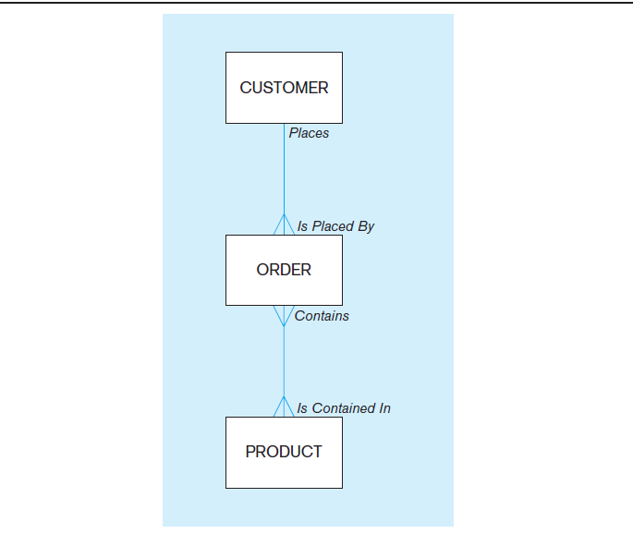
Figure 1.3 (a) Comparison of enterprise and project level data models -Segment of an enterprise data model

